Slide 1
Counting process

Slide 2
Contents of the Presentation
Session No. | Name of the Topic | Total no. of Slides
I
 | 1.1 Major legal provisions related to counting 1.2 Infrastructure and security arrangements at counting centre 1.3. Appointment of counting staffs and counting agents
II | Counting of votes received through postal ballot / ETPBS
III | Counting of votes recorded in EVM-VVPATs
IV | 4.1 Declaration of results
 | 4.2 Sealing of EVM-VVPATs and other papers | 36
 | 4.3 Miscellaneous issues

Slide 3
4.1 Declaration of Results

Slide 4
Tabulation & Result Declaration
Form 20 (Final Result Sheet)
Form 21 C
(Declaration of Result )
17 C Part II
Round wise Trend/ Result
Form 21 E (Return of Election )
Signed by RO & Observer
Form 22 (Certificate of Election)
Media Room
CEO (through e-mail)
Announcement of round wise result
Genesys
Candidate

Slide 5
Declaration of results
Result declaration after:
Completing and Signing Form 20
Obtained necessary approval from ECI, wherever needed.
Obtained No Objection from ECI’s Observer
Any request for recount , if received, has been duly disposed of by a speaking order of the RO.
Declare the result by loud announcement
56

Slide 6
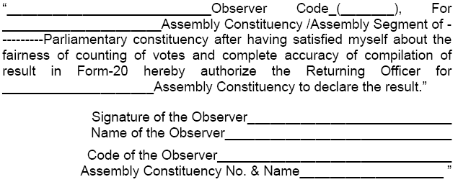
Declaration of result
RO HB: Observer’s No Objection

Slide 7
Preparation of Form 21C By the Returning Officer
As per the instruction of ECI No. 465/INST/2013-EPS dated: 9.1.2014, the Returning Officer to ensure:
Name of the Constituency is in accordance with the latest delimitation order.
Name & address of the elected candidate is same as in Form 7A
Name of the sponsoring party as per latest notification on political parties and election symbols.
RO to send ink signed Form 21C to CEO.

Slide 8
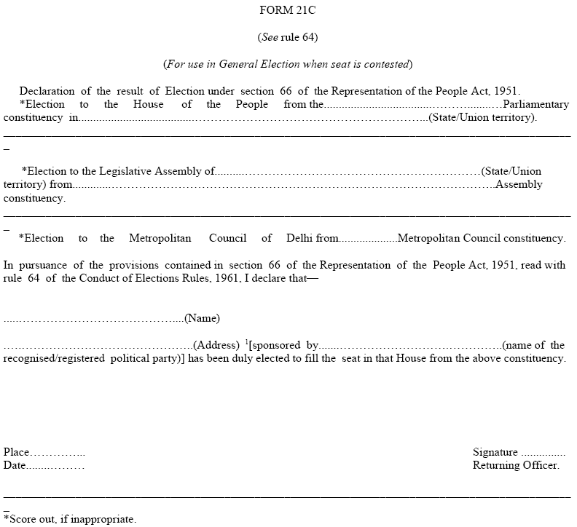
Form 21 C
59

Slide 9
Declaration of result
Send copies of Form 21C to :
ECI
CEO of state
Union Ministry of Law & Justice (Legislative Department)
State Government
Secretary to State Legislative Assembly

Slide 10
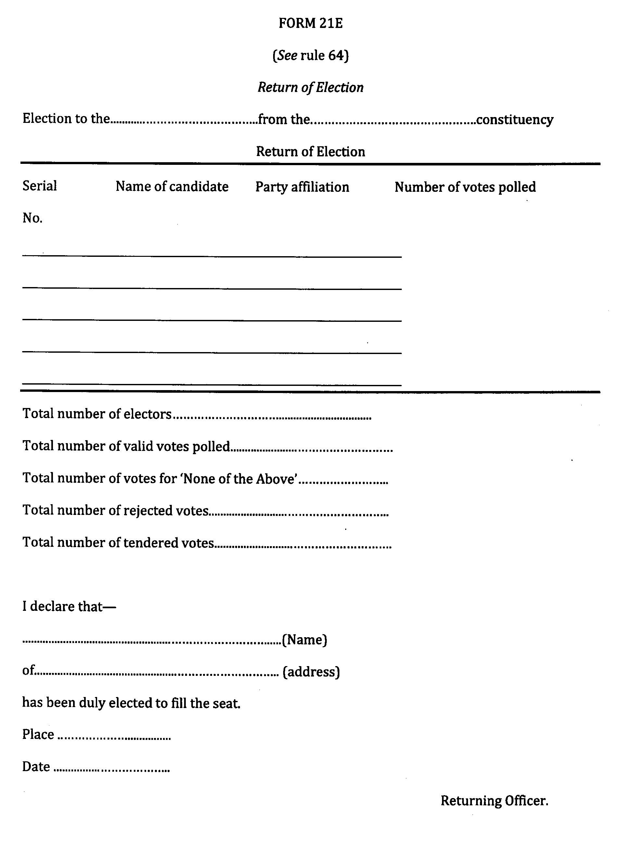
Form 21E: Return of Election

Slide 11
Total number of votes for ‘None of the Above’ (NOTA) will not be calculated in valid votes.
In 21E serial of candidates is according to the list of contesting candidates (Form 7A)

Slide 12
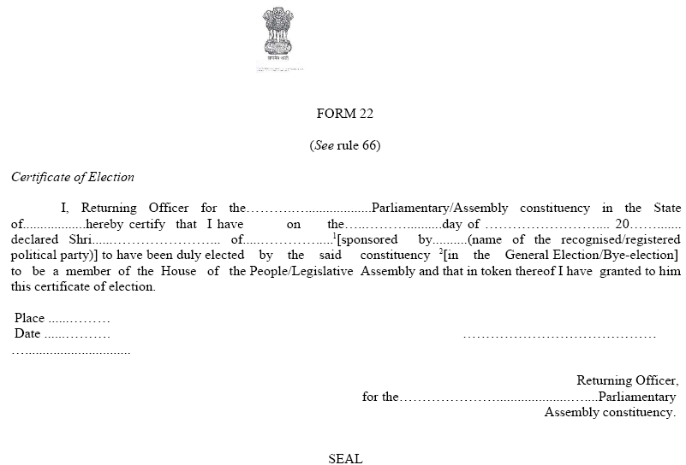
Form 22: Certificate of Election

Slide 13
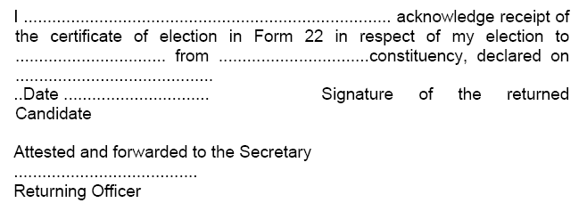
Declaration of result
Acknowledgement from returned candidate

Slide 14
Declaration of result
As soon as a candidate is declared elected, you should grant to such candidate, a certificate of election in Form 22.
Only candidate or in his absence , a person duly authorized by the candidate and who is personally known to the RO, can receive the certificate of election from RO.
Only 4 persons can be present excluding the candidate or duly authorized person by the candidate for receiving the certificate of election from RO.
Obtain from candidate an acknowledgement of its receipt duly signed (in any language) by the candidate.
Send this acknowledgement by registered Post with AD.

Slide 15
Declaration of result
If not present, contact immediately and dispatch within a day or two
The acknowledgement of the certificate of return obtained by the RO from the candidate/ his authorized person would be required for oath taking by the returned candidate at Parliament/ Assembly
Certificate to be issued in English or Hindi or in official language of the state
Candidate can sign in any language she/he likes
Where candidate is not present in locality, certificate to be handed over to authorized person and acknowledgement signed by the same person
Certificate to be handed over to candidate and its acknowledgement is obtained immediately if she/he is present at counting

Slide 16
Forms to be submitted to ECI
Form 20 – Final Result Sheet
Form 21C – Declaration of Result
Form 21E – Return of Election
Form 22 – Certificate of Election
Acknowledgement
2 unused EVM ballot paper
Signed by RO in original and stamped properly

Slide 17
Report result of election also to:
ECI by fax/ email (Without any failure)
AIR Station in State HQ
Director, Doordarshan Kendra, New Delhi
Information Officer, PIB, New Delhi
Ministry of Law Govt. of India/ State Govt.
Chief Electoral Officer of State
Secy. Gen. Lok Sabha/ Secretary of State Legislative Assembly
Director of News Services, All India Radio, New Delhi

Slide 18
4.2 Sealing of EVM-VVPATs and other important papers

Slide 19
Sealing of EVM-VVPATs after Counting
After completion of counting of votes, EVMs and VVPATs containing printed paper slips in its Drop box, shall be kept in the same strong room without removing Power Packs of Control Units and Power Packs and Paper Rolls of VVPATs.
Close the outer cover of the Result Section and reseal it.
The control unit is to be resealed with ROs seal and the seals of such of the candidates or their election agents who may desire to affix their seals thereon.
Keep the control unit so resealed in its carrying case.
Reseal the carrying case.
Put a secret seal of the Commission in addition to ROs own seals

Slide 20
Sealing of other Election Papers for ensuring safe custody
The packets of-
Registers of Voters in Form 17A, including the voter slips.
Unused postal ballot papers with counterfoils attached thereto;
Used postal ballot papers whether valid, or rejected
Counterfoils of used postal ballot papers;
Printed paper slips sealed under the provisions of Rule 57C
Used and unused tendered ballot papers;
Unused (surplus) ballot papers (printed for display on ballot units and for use as tendered ballot papers);
Marked copies of the electoral roll; and
Declarations by electors and the attestation of their signatures.
These papers should also be sealed with the secret seal of the Commission

Slide 21
Appoint a senior officer to supervise sealing of packets.
These papers are to be sealed with Secret Seal of ECI
All of these are to be put in steel trunk
Each steel trunk locked with two locks and each lock be sealed.
EVMs and election papers thus sealed shall be deposited in safe custody of DEO without delay
DEO should ensure that these are deposited in treasury/sub-treasury under double lock, key of one will be kept with DEO himself.
The envelopes sealed under R 93(1) shall not be opened and their contents inspected by any person/authority except under the order of a competent court under Secret Seal NOT to be put on locks.

Slide 22
After sealing of EVMs and election papers, RO should draw up proceedings of counting process mentioning, inter alia,-:
* Full particulars of candidates/agents present in counting hall
* Fact that they were asked to affix seals on voting machines and packets of election papers, if they wished.
* Particulars of persons who had affixed such seal and those persons who refused to do so
* Sign the proceedings and obtain signs of the candidates/agents as present and willing to sign. The proceeding should be kept in a sealed cover along with other election papers.
53

Slide 23
After all packets are sealed, Secret Seal should be put in separate packet
Affix seals of candidates/agents if they wish
The secret Seal should be returned IMMEDIATELY after such sealing to ECI
Send through registered insured post
To be returned to Commission within 24 hours after counting is completed.

Slide 24
Storage of EVM-VVPAT After Counting
After the sealing of the voting machines and election papers at the counting place after the counting of votes:
Existing Strong Room Force should be used to transport EVM and other documents from Strong Room to District Ware house.

Slide 25
4.3 Miscellaneous Issues

Slide 26
Adjournment/ Stoppage of Counting Process
If RO has to adjourn counting for unavoidable reasons, he should seal and secure all EVMs and election papers outside the strong room using RO’s seal
Allow every candidate/agent to put seal as well as put their own locks on all room including strong room where materials are to be stored

Slide 27
Adjournment/ Stoppage of Counting Process
The Observer has the power to stop counting at any time before declaration of result and has power to prevent declaration of result if s/he feels:
Booth capturing has taken place at large no. of PSs
Ballot papers are unlawfully taken out of the custody at any place fixed for poll/counting of votes
Election materials are intentionally/accidentally lost, damaged or destroyed or tampered to such an extent that result can’t be ascertained
RO has no power to order recommencement of counting. This will happen on ECI’s orders only.

Slide 28
Videography
(i) The randomization process
(ii) The process of opening of strong room
(iii) Transfer of EVMs from strong room to counting hall
(iv) Counting hall arrangements
(v) Counting – PB & EVM
(vi) Process of tabulation
(vii) Process of counter checking of two EVMs by the observers
(viii) Entire procedure to count paper ballot slips (VVPAT) and sealing
One Videographer per hall

Slide 29
Videography
(ix) Security arrangements.
(x) Presence of candidates and their agents
(xi) Process of declaration of result
(xii) Handing over of certificate of Return of Election
(xiii) Sealing of EVMs after counting
(xiv) Any other significant events of the counting process
(xv) The videography should indicate the date and time and the unedited video CDs should be sealed, clearly labeling all the details contained therein, after the counting process is over for future reference. Accordingly, adequate number of video teams may be deployed on the counting day.
(xvi) A CD containing the record of complete videography of counting process may be given by the Returning Officer to candidates or their election agents free of cost, on specific demand.

Slide 30
REPLACEMENT OF BATTERY AT THE TIME OF COUNTING
ECI No 51/8/7/2014-EMS dt 7.5.2014
In case CU does not display result at the time of counting, battery can be replaced with new one.
New batteries to be available in counting centres.

Slide 31
REMEMBER
In case of malfunctioning of CU, the machine should not be opened and its outer or inner seals should not be disturbed in any manner.
No repairing and replacement of parts of the EVM in the field should be undertaken.

Slide 32
ECI Counting Trends/ Results- Reports

Slide 33
ECI- Counting Trends/ Results

Slide 34
ECI- Counting Trends/ Results

Slide 35
ECI- Counting Trends/ Results

Slide 36
Thanks

